Slide 1

BANARAS HINDU UNIVERSITY
Movie Recommendation System CS-505(MINI Project)
Under the supervision of
Dr. Gaurav Baranwal
Submitted by-
Name – Mohammad Salman
Class - MCA 5th semester
Roll No -17419MCA020

Slide 2
Introduction
In today’s world, where there is a variety of content to be consumed like books, videos, articles, movies, etc. and finding the content of one’s liking has become an irksome task. This is where the recommendation system comes into the picture, where the content providers recommend users the content according to the user's liking.
In this project, we use machine learning to build a movie recommendation system which will be based on the user’s previous movie ratings by using the Content-Based Recommendation algorithm

Slide 3
This project will assist the user in identifying what kind of movie to watch out for. This project will play an important role in the content provider by allowing subscribers to watch TV shows, movies, documentaries and more on a wide range of Internet-connected devices of their liking.

Slide 4
Recommendation System
A recommendation system is a type of information filtering system which attempts to predict the preferences of a user and make suggests based on these preferences.
Recommender systems have many applications. Indeed, Recommender systems are usually at play on many websites. For example, suggesting books on Amazon and movies on Netflix.

Slide 5
Another example can be found in a daily-use mobile app, where a recommender engine is used to recommend anything from where to eat, or, what to read to. On social media, sites like Facebook or LinkedIn, regularly recommend friendships.
Recommender systems are even used to personalize your experience on the web.

Slide 6
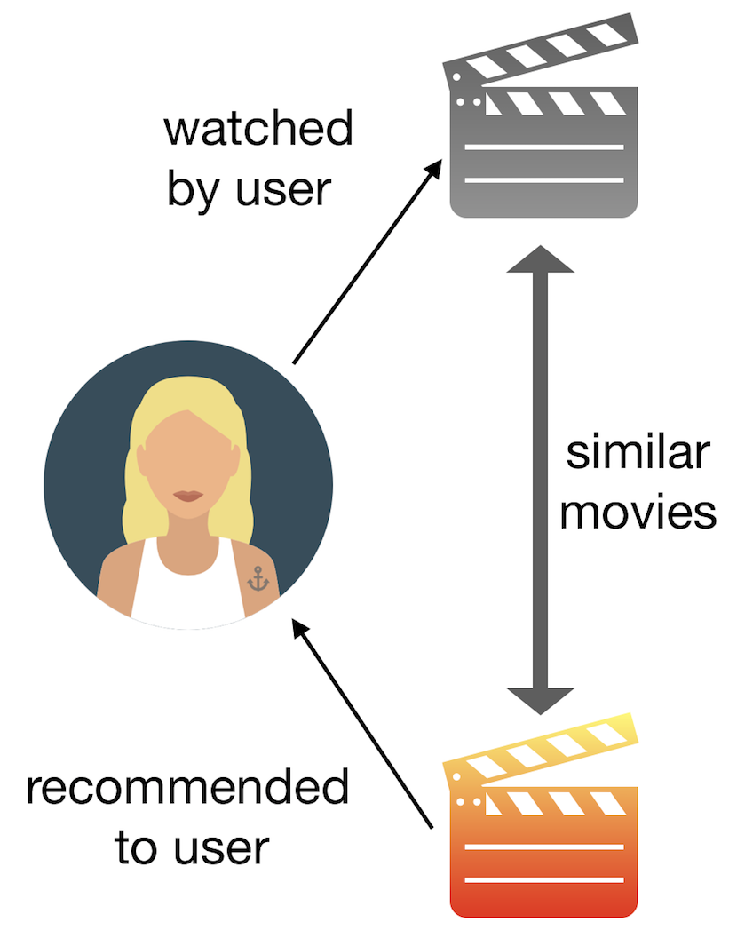
Recommendation systems use several different technologies. We can classify these systems into two broad groups.
Content-based recommendation systems:

Slide 7
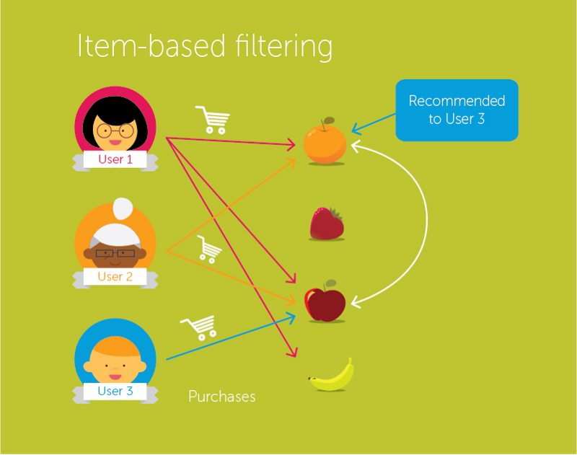
Collaborative filtering recommendation systems :

Slide 8
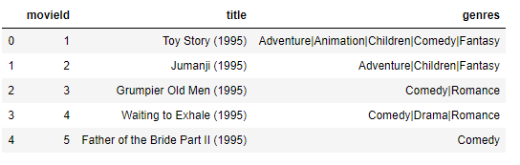
PROPOSED APPROACH
Description of Datasets:
The Movies dataset is used in this project. It is taken from the Movie Lens. The Movies data set has 9742 rows, and 3 attributes value which is named movie Id, title, and genres.

Slide 9
Applications of Recommendation Systems
Product Recommendations:
Movie Recommendations:
News Articles:

Slide 10
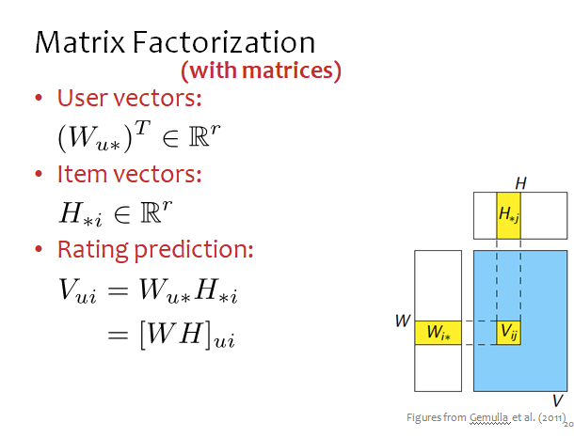
Mathematical Approach

Slide 11
IMPLEMENTATION
There are three main steps in the working of the project –
Acquiring the data
Preprocessing
Content-Based Filtering

Slide 12
1. Acquiring the Data:
As I discussed earlier, the main data sets is taken from the Movie Lens. These data sets are csv format documentation.

Slide 13
1.1 Loading the data
This is the first step for data modeling. In this step load the movies dataset using the pandas library. Here the pandas library is used for reading the CSV file by read_csv function.

Slide 14
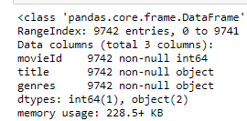
1.2 Find the attributes and their types

Slide 15
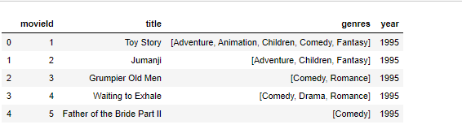
2. Preprocessing of the data
2.1 Removing year from ‘title‘column
2.2 Splitting the values in the ’ genre’

Slide 16
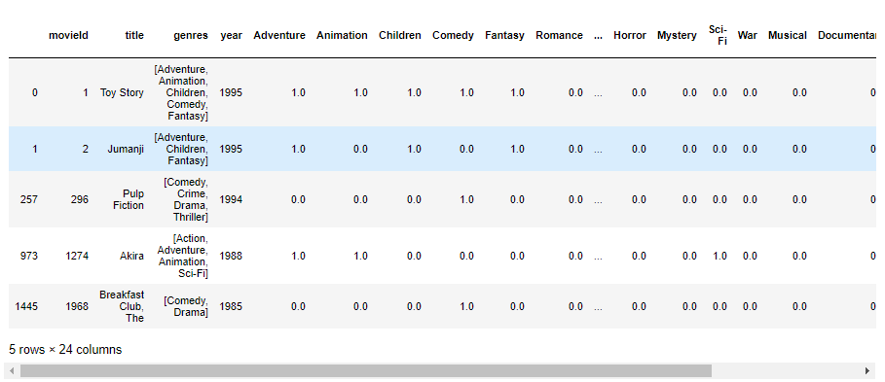
2.3 Converting the list of genres to a vector

Slide 17
3.Content-Based Filtering :
This technique attempts to figure out what a user's favorite aspects of an item is and then recommends items that present those aspects. In our case, we are going to try to figure out the input's favorite genres from the movies and ratings given
This filtering process occurred in few steps

Slide 18
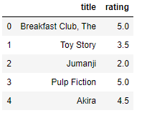
Step 1:- Creating an input user to recommend movies

Slide 19
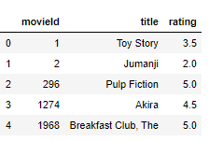
Step 2 :-Add movieId to input user

Slide 20
Step 3:- Learning the input preferenes
For learning the input preferences, we get the subset of movies that the input has watched from the Dataframe containing genres

Slide 21
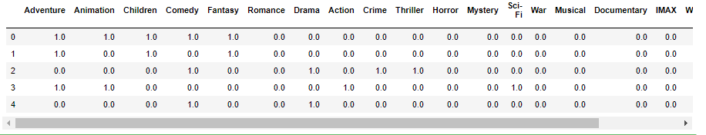
. Now we have only needed the actual genre table, so clean this by resetting the index and dropping the movie Id, title, genres and year columns.

Slide 22
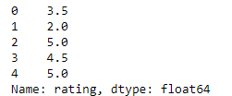

Slide 23
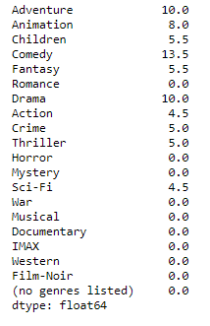
Now the dot product between Transpose of matrix elements of above tables and got user profile

Slide 24
Step 4: Creating the list of top 20 recommended movie table:
We have started by extracting the genre table from the original data frame, .and after that drop the unnecessary information. Now we have with the input's profile and the complete list of movies and their genres. After that, we're going to multiply the genres by the weights and then take the weighted average of every movie based on the input profile and sort it in descending order then we have found the recommendation table as a result of the top 20 movies that most satisfy it.

Slide 25
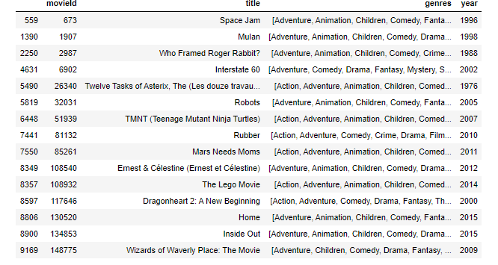
RESULTS .

Slide 26
Advantages and Disadvantages of Content-Based Filtering Advantages: A. Learns user's preferences B. Highly personalized for the user Disadvantages : A. Doesn't take into account what others think of the item, so low quality item recommendations might happen B. Extracting data is not always intuitive C. Determining what characteristics of the item the user dislikes or likes is not always obvious

Slide 27
CONCLUSION
In my project, content-based filtering algorithm is used to give the best recommendation of movies to the user.
It solves the new item recommendation problem and gives an idea about the current trends of popular movies and users interests.
This is very helpful for a movie producer to plan new movies.

Slide 28
FUTURE WORK
This method can be expanded by including more criteria to help in categorization the movies.
The most obvious ideas are to add features to suggest movies with common actors, directors or writers.
In addition, we could try to develop hybrid methods that try to combine the advantages of both content-based methods and collaborative filtering into one recommendation system.

Slide 29
BIBLIOGRAPHY
Ali, K., van Stam, W.: TiVo: Making Show Recommendations Using a Distributed Collaborative Filtering Architecture. In: Proceedings of the Tenth ACM SIGKDD International Conference on Knowledge Discovery and Data Mining, Seattle, pp. 394–401. ACM Press, New York (2004)
Balabanovic, M., Shoham, Y.: FAB: Content-based, Collaborative Recommendation Communications of the Association for Computing Machinery 40(3), 66–72 (1997)
Basu, C., Hirsh, H., Cohen, W.: Recommendation as Classification: Using Social and Content-Based Information in Recommendation. In: Proceedings of the 15th National Conference on Artificial Intelligence, Madison, Wisconsin, pp. 714–720 (1998)
Belkin, N., Croft, B.: Information Filtering and Information Retrieval: Two Sides of the Same Coin? Communications of the ACM 35(12), 29–38 (1992)
Burke, R.: Hybrid Web Recommender Systems. In: Brusilovsky, P., Kobsa, A. Nejdl, W.(eds.) The Adaptive Web: Methods and Strategies of Web Personalization. LNCS,vol. 4321, pp. 377–408. Springer, Heidelberg (2007)
Kotsiantis, Sotiris. (2007). Supervised Machine Learning: A Review of Classification
Techniques. Informatica (Ljubljana). 31.

Slide 30
https://link.springer.com/chapter/10.1007/978-3-540-72079-9_10 http://infolab.stanford.edu/~ullman/mmds/ch9.pdf http://cs229.stanford.edu/proj2018/report/128.pdf http://www.ijesrt.com/issues%20pdf%20file/Archive-2016/November-2016/63.pdf https://en.wikipedia.org/wiki/Recommender_system https://towardsdatascience.com/brief-on-recommender-systems-b86a1068a4dd https://indatalabs.com/blog/big-data-behind-recommender-systems https://docs.microsoft.com/en-us/analysis-services/data-mining/training-and-testing-data-sets https://mindmajix.com/polynomial-regression https://towardsdatascience.com/https-medium-com-lorrli-classific

Slide 31
Thank You

